Slide 1
Zoe - Take Home Task
Zsolt Nyiri
2023-08-27

Slide 2
Table of Contents

Slide 3
Data sources & tools used
Datasource:
London Bicycles Dataset
Contains 2 table:
bigquery-public-data.london_bicycles.cycle_stations
station lookup table with 795 unique stations installed between 2010-06-19 and 2022-10-17
bigquery-public-data.london_bicycles.cycle_hire
ride level data between 2015-01-04 and 2023-01-15
Additional 3rd party data sources:
London weather data
London Geo map
Tools and tech used:
BigQuery
Google Collab (python)

Slide 4
2. Data inspection, quality check and added features
Multiple corrections and improvements were made in order to improve the quality of the datasets. A few examples:
The ride durations had negative values
after a through inspection they were all found to be only present on the last Sunday of October (in multiple years) for ride that started between 1 and 2 am and ended after 2 am
This happens to coincide with the clock shift, so I fixed these
Many stations had a missing station_id between 2016-08-31 and 2016-09-06 that was stored in a different field in this interval, which I backfilled into the original column
Many station had a change of its name or station_id, which I rolled up to have a unique name and id that matched the stations dataset
Many new features were also created for to future analysis. A few examples:
Is the bike electric?
Did the ride happen on a weekend?
In what season?
Etc.

Slide 5
3. Creating the staging-, dimension and derived fact tables
These along with all the fixes were stored in staging tables:
stg_cycle_stations
stg_cycle_hire
These staging tables were then used to create a combined source of truth table:
dim_cycle_data
Also created a lookup table for later use storing all the station properties with the cleaned up ids and named:
dim_cycle_stations
Lastly, 2 derived fact tables were created that stored all the previous data but was rolled up to an hourly level for the analysis:
drv_fact_cycle_data
drv_fact_cycle_hire_weather_combined

Slide 6
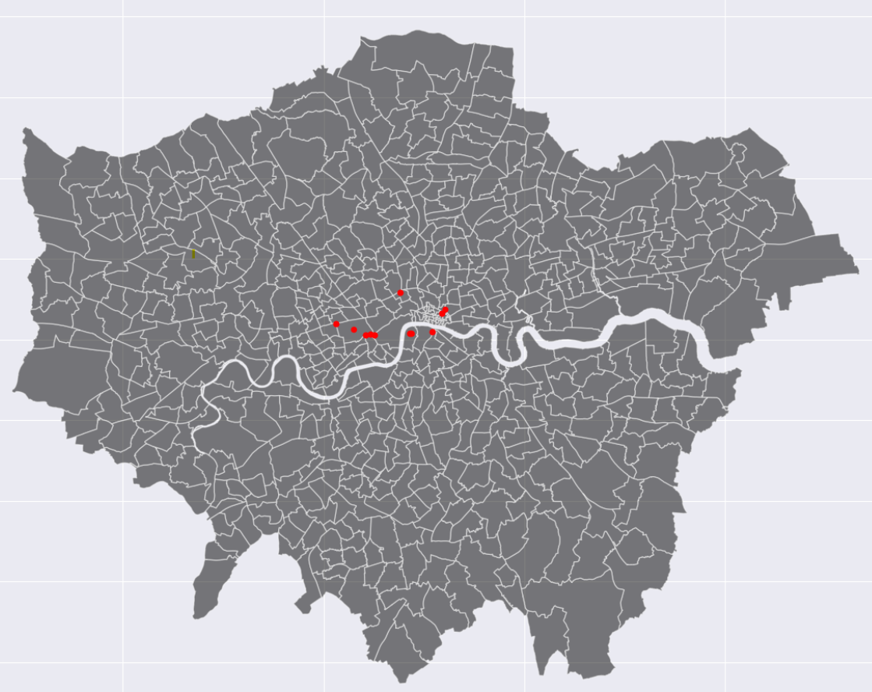
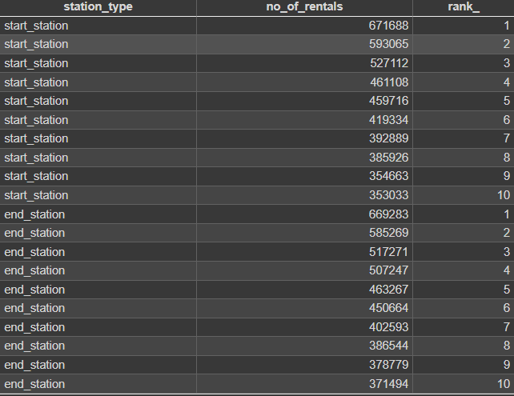
4. What are the most popular start and end stations?
9 out of the 10 most popular start stations are also in the most popular end stations
The 10 most popular start stations make up for the 5.5% of the total traffic

Slide 7
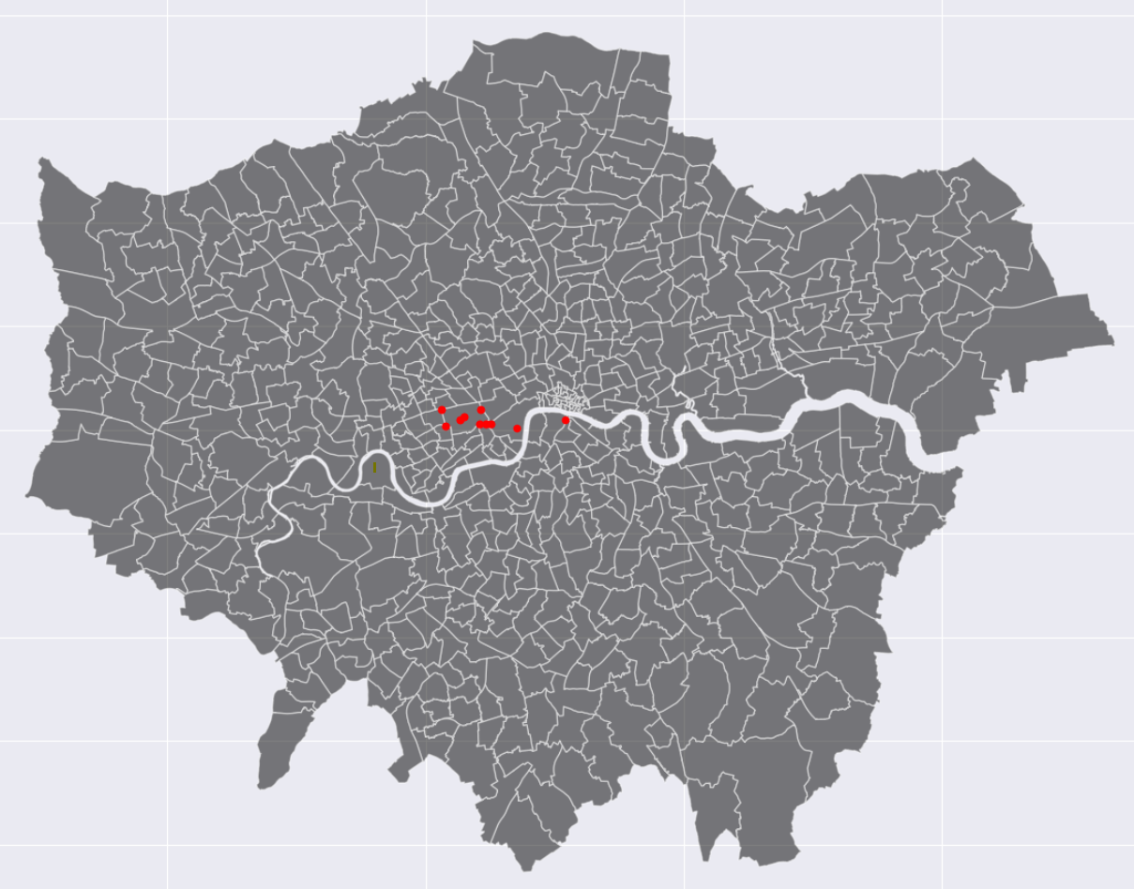
4. What are the most popular start and end stations?
However, if we only focus on the weekend rides, it’s clear that they almost all of the most popular stations are centered around Hyde park which suggest recreational purposes

Slide 8
5. Is there a relationship between the number of docks and the number of bicycles hired?

